Slide 1
Detecting Variable Length Anomaly Patterns in Time Series Data
GVHD: PGS.TS Dương Tuấn Anh
HV: Ngô Duy Khánh Vy

Slide 2
Content
Introduction
Some Definitions
Related Works
Proposed Algorithms
Experimental Evaluation
Conclusion
Q&A

Slide 3
Introduction
A time series is a sequence of data points made over a continuous time interval
Anomaly Patterns are subsequences that do not conform to a well deﬁned notion of normal behavior
Application areas that explore such time series anomalies include fault diagnostics, intrusion detection, fraud detection, auditing and data cleansing

Slide 4
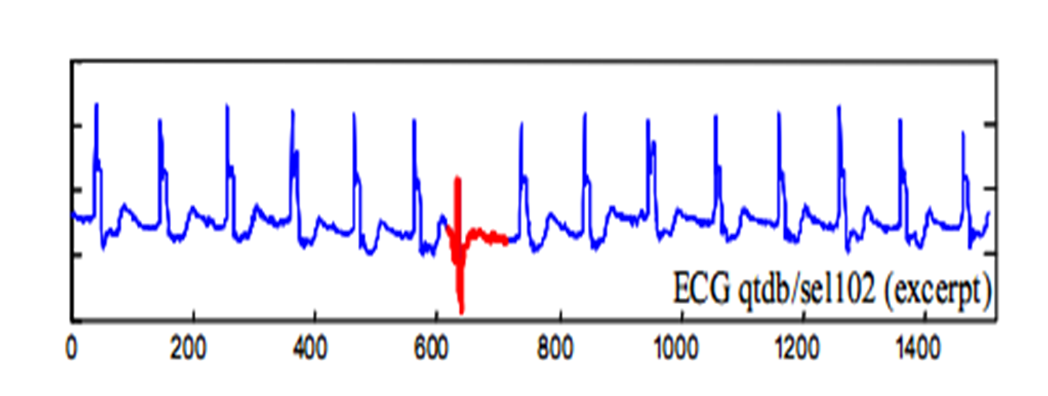
Introduction
unusual subsequence in time series data

Slide 5
Introduction
Anomalous subsequences detection is a challenging topic
The exact lengths of the unusual subsequence are vary and are often unknown.
Best similarity/distance measures which can be used for diﬀerent types of time series is not easy to determine.
Time series in real applications are usually long and as the length increases the computational complexity also increases.

Slide 6
Some Definitions
Time Series: A time series T = t₁, t₂, …, t_{m} is an ordered set of m real values measured at equal intervals.
Subsequence: Given a time series T of length m, a subsequence C is a sampling of length n < m of contiguous positions from T, i.e., C = t_{p}, t_{p+1}, …, t_{p+n-1}, for 1≤ p ≤ m-n+1. Sometimes, C is denoted as (s_{p}, e_{p+n-1}), where s_{p} = t_{p} and e_{p+n-1} = t_{p+n-1}.

Slide 7
Some Definitions
Distance function: Dist(C, M) is a positive value used to measure the difference between two time series C and M, based on some measure method
k-distance of a pattern: Given a positive integer k, a pattern set D and a pattern P ∈ D, the k-distance of P, denoted as k-dist(P), is defined as the distance between P and a pattern Q ∈ D such that.
i) For at least k patterns Q’ ∈ D it holds that Dist(D, Q’) ≤ Dist(D, Q).
ii) For at most k-1 patterns Q’ ∈ D \{Q} it holds that Dist(D, Q’) < Dist(D, Q).

Slide 8
Some Definitions
Non-Self Match: Given a time series T, its two subsequences P of length n starting at position p and Q starting at position q, we say that Q is a non-self-match to P, if Dist(P, Q) ≥ e or |p - q| ≥ n, where e is a given value of distance threshold.
Anomaly factor: For any pattern set D and a pattern P ∈ D, k-dist(D) denotes all k-dist of patterns, anomaly factor of pattern P defined as the ratio of k-dist(P) to median(k-dist(D)).
Anomaly Pattern: Given any pattern set D, a pattern P∈ D, P is anomaly only if its anomaly factor is larger than a, where a is the threshold of anomaly pattern

Slide 9
Related Works
Hot Sax (E. Keogh et al. 2005 ).
WAT (Y. Bu et al. 2007).
Method based on PAA bit representation and clustering (Li et al. 2013)
Method based on Segmentation and Anomaly Factors (M.Leng et al. 2008)

Slide 10
HOT SAX
Find discord of length n.
A discord is a subsequence which have largest nearest neighbor distance.
Use heuristic to improve brute-force.
Distance function: Euclid distance.

Slide 11
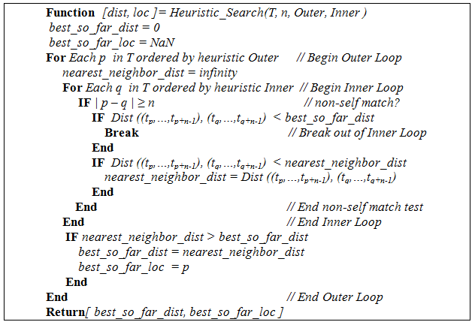
HOT SAX

Slide 12
HOT SAX
Present subsequences of length n to SAX words.
Use PAA for Dimensionality reduction
Use an array and an augmented trie to embed all the SAX words

Slide 13
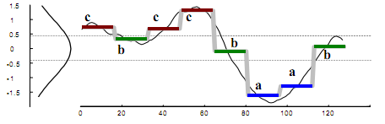
HOT SAX

Slide 14
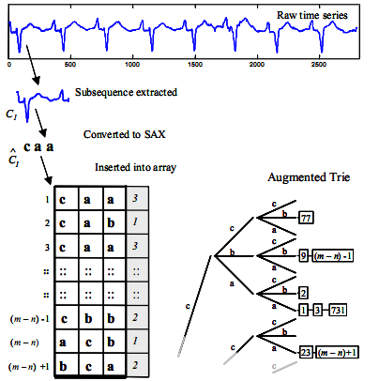
HOT SAX

Slide 15
HOT SAX
In outer loop, subsequences presented by words which have smallest appearing frequency in the array are checked first
In inner loop, subsequences belong to the same left node in the augmented trie with the subsequence chosen at outer loop are checked first.

Slide 16
WAT
Same HOT SAX but use Haar wavelet instead of PAA.

Slide 17
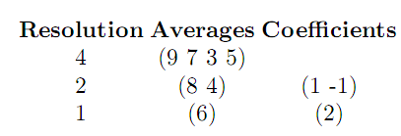
WAT
Haar wavelet can be seen as a series of averaging and differencing operations
Ex: f(x) = (9, 7, 3, 5) -> (6, 2, 1, -1)

Slide 18
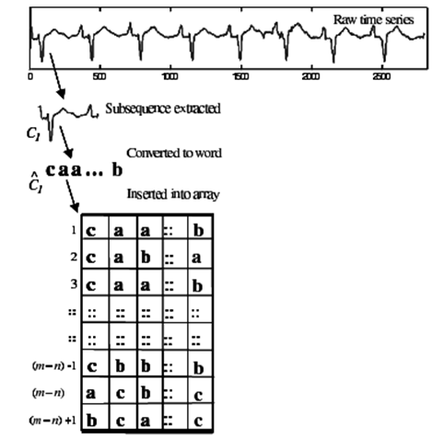
WAT

Slide 19
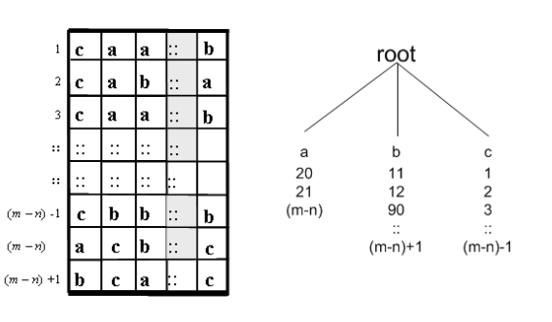
WAT

Slide 20
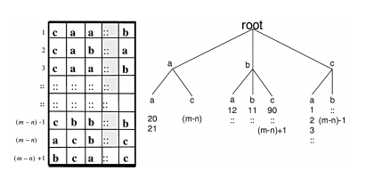
WAT

Slide 21
WAT
In outer loop, subsequences presented by words which have smallest appearing frequency in the array are checked first
In inner loop, subsequences belong to the same left node in the tree with the subsequence chosen at outer loop are checked first.

Slide 22
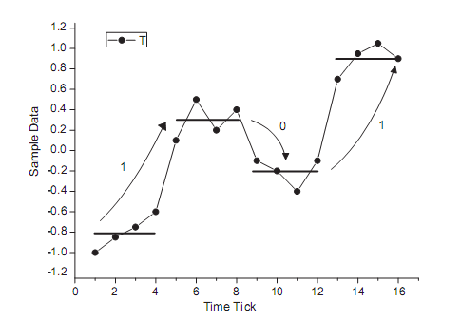
Method based on PAA bit representation and clustering
PAA Bit representation of a series

Slide 23
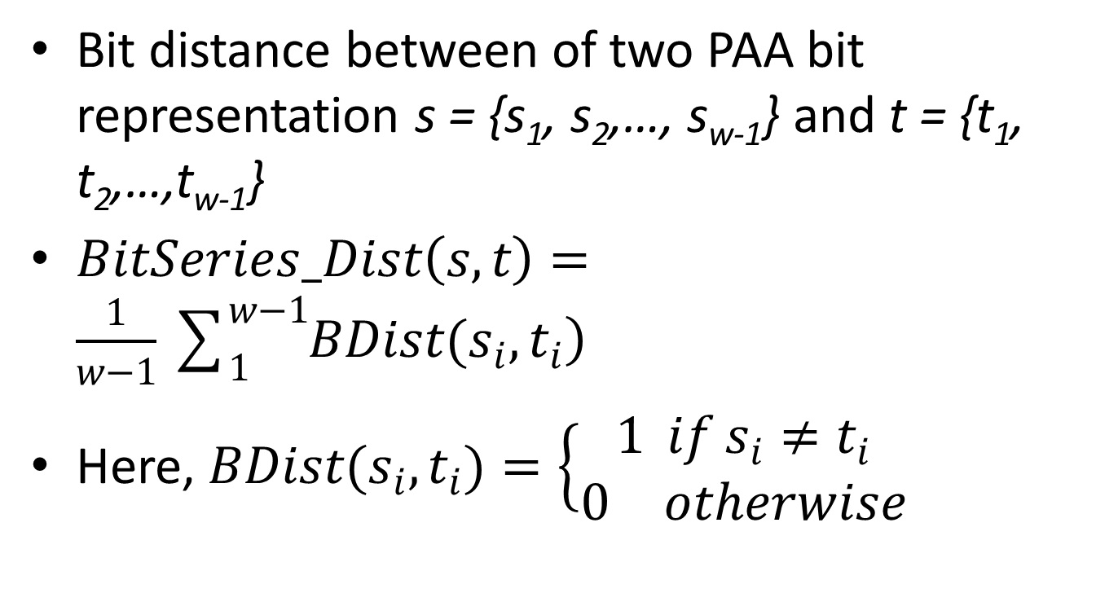
Method based on PAA bit representation and clustering
Bit distance between of two PAA bit representation s = {s₁, s₂,…, s_{w-1}} and t = {t₁, t₂,…,t_{w-1}}
$BitSeries_Dist\left(s,t\right)=\frac{1}{w−1}\sum_{1}^{w−1}{\left.BDist(s_{i},t_{i}\right)}$
Here, $BDist(s_{i},t_{i})=\left\{\begin{matrix}1 if s_{i}≠t_{i} \\ 0 otherwise\end{matrix}\right.$

Slide 24
Method based on PAA bit representation and clustering
k bit representations are randomly chosen as k cluster centres
A bit representation is assigned to the nearest cluster.
In outer loop, subsequences which have bit representations belong to the smallest cluster (cluster has the fewest elements) is checked first
In inner loop, subsequences belong to the same cluster with the subsequence chosen at outer loop are checked first.

Slide 25
Method based on PAA bit representation and clustering
3 above algorithms need to know the length of anomaly subsequence in advance.

Slide 26
Method based on Segmentation and Anomaly Factors
Proposed by Leng et al. in 2008
The method includes 2 phase
Phase 1: use quadratic regression model to segment time series. Regression function is defined as f(t) = β₀ + β₁t + β₂t²,
Phase 2: Calculate anomaly factors for the subsequences and show abnormal patterns.

Slide 27
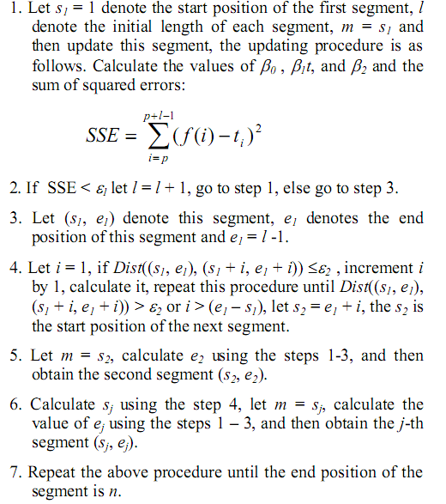

Slide 28
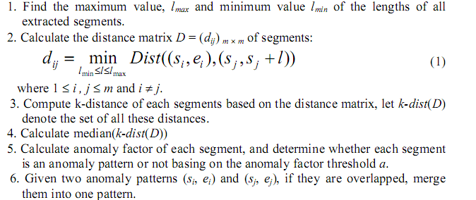

Slide 29
Method based on Segmentation and Anomaly Factors
Don’t need to know the length of anomaly patterns in advance
Use DTW to calculate distance between two subsequences of different length
Time consuming

Slide 30
Proposed Algorithms
Use Homothetic Transformation + Modified Euclidean Distance instead of DTW
Reduce the number of distance calculating in building distance matrix.
Proposed a segmentation method based on important extreme points as alternative segmentation method

Slide 31

New distance function
A Homothetic Transformation with center O and ratio k transforms the point M to the point M’ such that

Slide 32
New distance function
Apply to time series, a homothety transforms a time series T of length n (T = {y1, y2, …, yn}) to time series T’ of length n’ by performing the following steps.
First, compute Y_MAX = MAX (y1, …, yn), Y_MIN = MIN(y1, …,yn ).
Second, set the center I of homothety with the coordinates X_C = n/2, Y_C = (Y_MAX + Y_MIN)/2. Next, perform the homothety with the center I and the ratio n’/n

Slide 33
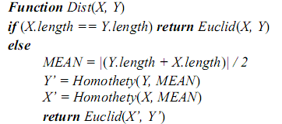
New distance function

Slide 34
New distance function
Minimum Euclidean Distance between
T’ = {T’₁, T’₂,…, T’_{N’}} and Q’ = {Q’₁, Q’₂,…, Q’_{N’}}
Time Complexity of new distance function: O(n)

Slide 35
Reduce the number of distance calculating
Propose parameter r
Replace formula (1) to
Where
l_{upper} = ⎣l_{avg}(1+ r)⎦
l_{lower} = ⎡l_{avg}(1- r)⎤
l_{avg} is mean length of the subsequences.

Slide 36
Alternative segmentation method
Based on the concepts of Important Extreme Points, proposed by Pratt and Fink in 2002
Extract all important extreme points of the time series T. The result of this step is a sequence of extreme points EP = (ep₁, ep₂, …, ep_{l})
Compute all the candidate patterns iteratively. A candidate pattern CP_{i}(T), i = 1, 2,…, l -2 is the subsequence of T that is bounded by extreme points ep_{i} and ep_{i+2}.

Slide 37
Alternative segmentation method
Parameter:
- Compression rate: R > 1
- Lower bound for the distance two extracted extreme points: min_length. So the minimum length of a subsequence is 2min_length

Slide 38
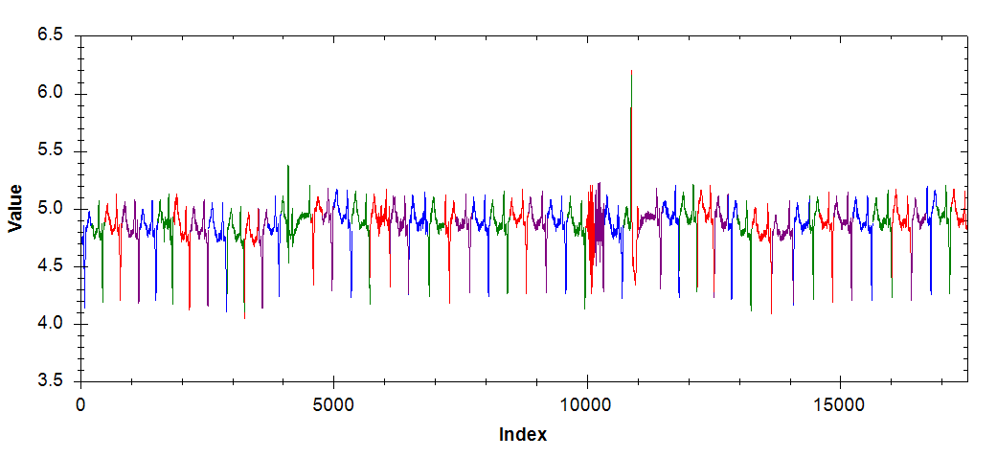
Segmentation based on quadratic regression

Slide 39
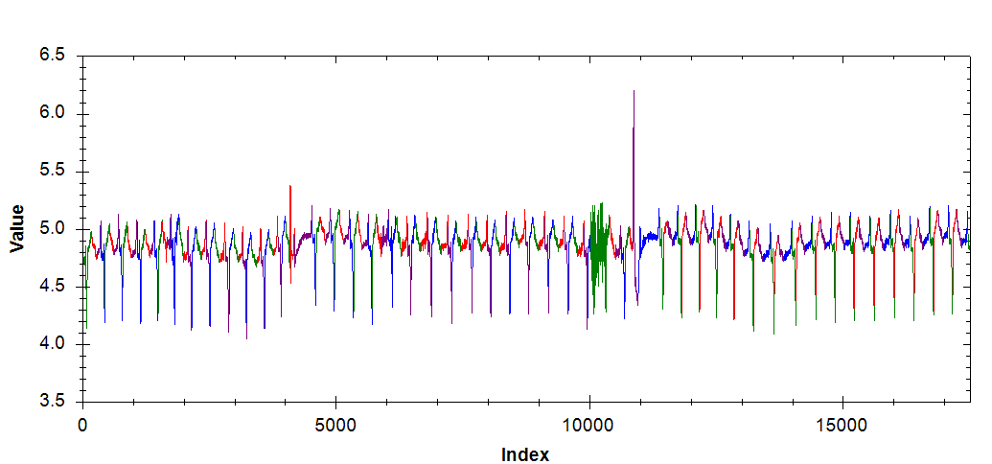
Segmentation based on important extreme points

Slide 40
Experimental Evaluation
VL_QR| HT: The proposed algorithm with quadratic regression
VL_EP| HT: The proposed algorithm with important extreme points.
Compare results and running time among VL_QR| HT, VL_EP| HT and HOT SAX
Compare running time between VL_QR| HT with the original algorithm proposed by Leng et al.

Slide 41
Experimental Evaluation
Experiments environment : Intel® Core™ 2 Duo 2.0GHz, Ram 3072MB PC
All algorithms are implemented in Microsoft Visual C# programing language

Slide 42
Compare VL_QR| HT, VL_EP| HT and HOT SAX
Use 8 time series in diverse domains:
ECG 108, ECG 308, ERP, Memory, Power Demand In Italy, Dutch Power Demand, Stock20 and TEK16
To compute location difference of anomaly subsequences use:
d = |p – q|/l × 100
where p is the start position of the anomaly pattern found by proposed algorithm and q is the start position of the anomaly pattern found by HOT SAX and l is it’s length

Slide 43
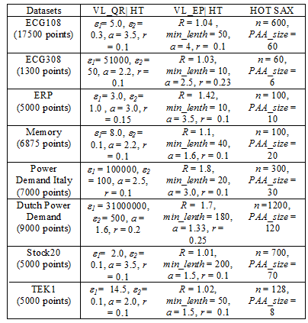
Parameter values in the three algorithms for each series

Slide 44
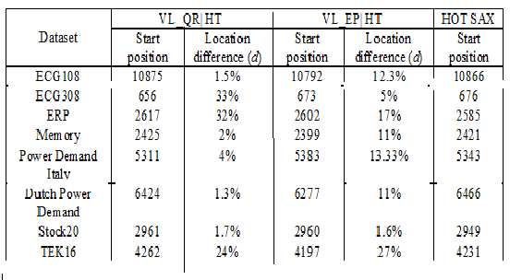
Positions of anomaly patterns detected by VL_QR|HT and VL_EP|HT and HOT SAX

Slide 45
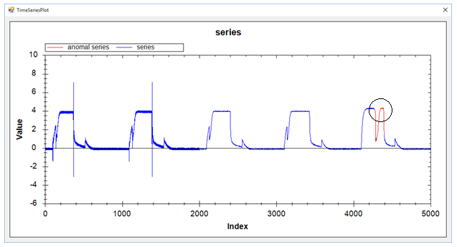
Positions of anomaly patterns detected by VL_QR|HT and VL_EP|HT and HOT SAX
Result of VL_QR | HT with series TEK16

Slide 46
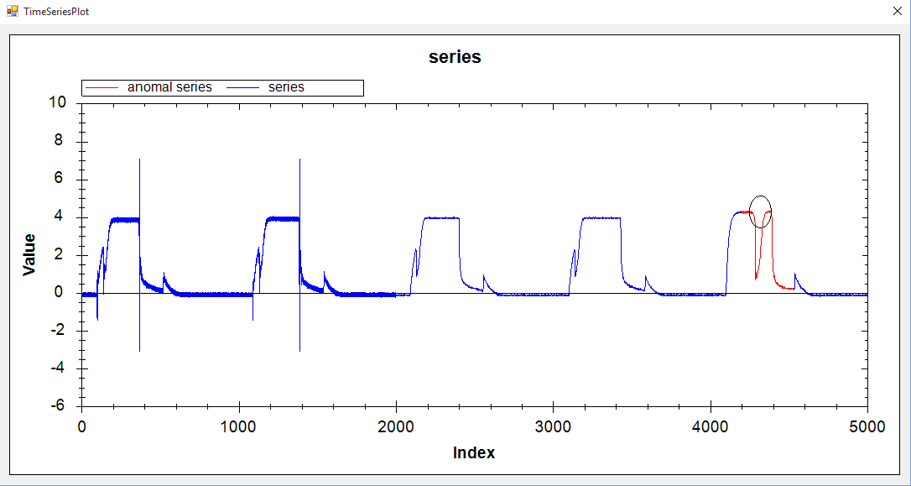
Positions of anomaly patterns detected by VL_QR|HT and VL_EP|HT and HOT SAX
Result of VL_EP | HT with series TEK16

Slide 47
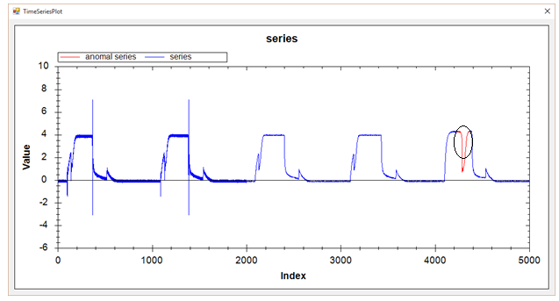
Positions of anomaly patterns detected by VL_QR|HT and VL_EP|HT and HOT SAX
Result of HOT SAX with series TEK16

Slide 48
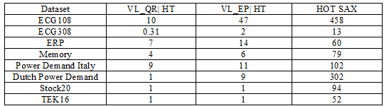
Running time among VL_QR|HT, VL_EP|HT and HOT SAX (s)

Slide 49
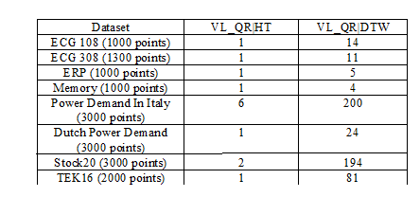
Running time between VL_QR| HT with the original algorithm (s)

Slide 50
Conclusion
VL_QR|HT and VL_EP|HT bring out a remarkable improvement for the original algorithm in time efficiency without compromising anomaly detection accuracy.
Experimental results on eight datasets demonstrate these algorithms outperform the VL_QR|DTW in time efficiency.
Not easy to estimate the regression error threshold ε₁ and the non-self match threshold ε₂ in the segmentation phase of VL_QR|HT.
Not easy to find the R in VL_EP|HT.
Future work: apply some more advanced method of time series segmentation.

Slide 51
References
D. Berndt, J. Clifford, “Finding patterns in time series: a dynamic programming approach”, Journal of Advances in Knowledge Discovery and Data Mining, AAA/MIT Press, Menlo Park, CA, pp. 229-248, 1996.
Y. Bu, T.W. Leung, A. Fu, E. Keogh, J. Pei, and S. Meshkin, “WAT: Finding top-K discords in time series database”, Proceedings of the 2007 SIAM International Conference on Data Mining (SDM'07), Minneapolis, MN, USA, April 26-28, 2007.
V. T. Huy, “Anytime k-medoids clustering of time series under dynamic time warping using an approximation technique”, Master Thesis, Faculty of Computer Science and Engineering, Ho Chi Minh City University of Technology, Vietnam, 2015.
E. Keogh, “Exact indexing of dynamic time warping”, Proceedings of 28th International Conference on Very Large Data Bases , Hong Kong, pp. 406-417, 2002.
E. Keogh, J. Lin, and A. Fu, “HOT SAX: efficiently finding the most unusual time series subsequence”, Proc. of 5th ICDM, Houston, Texas, pp. 226–233, 2005.
E. Keogh, www.cs.ucr.edu/~eamonn/discords/ (accessed on January 24 - 2015).
N.H. Kha and D. T. Anh, “From cluster-based outlier detection to time series discord discovery”, In: Trends and Applications in Knowledge Discovery and Data Mining – PAKDD 2015 Workshops: Big_PMA, VLSP, QIMIE, BAEBH, Ho Chi Minh City, Vietnam, May 19-21, X. L. Li et al. (Eds.), LNAI 9441, Springer, pp. 16-28, 2015.
D. Lemire, “Faster retrieval with a two-pass dynamic-time-warping lower bound”, Pattern Recognition, vol. 42, no. 9, pp. 2169-2180, 2009.
M. Leng, X. Chen and L. Li, “Variable length methods for detecting anomaly patterns in time series”, Proc. of Int. Symposium on. Computational Intelligence and Design (ISCID'08), Vol. 2, 2008.
G. Li, O. Braysy, L. Jiang, Z. Wu, Y. Wang, “Finding time series discord based on bit representation clustering”, Knowledge-Based Systems, vol.52, pp. 243-254, 2013.
A. L. I. Oliveira, F.B.L. Neto, and S.R. L. Meira., “A method based on RBF-DAA neural network for improving Novelty detection in time series”, Proc. of 17th International FLAIRS Conference, AAAI Press, Miami Beach, Florida, USA, 2004.
K. B. Pratt and E. Fink, “Search for patterns in compressed time series”, International Journal of Image and Graphics , vol. 2, no. 1, pp. 89-106, 2002.
H. Sakoe and S. Chiba, “Dynamic programming algorithm optimization for spoken word recognition”, IEEE Trans. Acoustics, Speech, and Signal Proc., vol. ASSP-26, pp. 43-49, 1978.
S. Salvador, P. Chan, “Learning states and rules for time series anomaly detection”, Applied Intelligence, vol. 23, no.3, pp. 241 -255. 2005.
C. D. Truong, H. N. Tin, D. T. Anh, “ Combining motif information and neural network for time series prediction”, Int. Journal of Business Intelligence and Data Mining, vol. 7, no. 4, pp. 318-339, 2012.

Slide 52
Q & A
Thank you!

